Slide 1
Local Alcohol Profiles for England https://fingertips.phe.org.uk/profile/local-alcohol-profiles
Responsible statistician: Mark Cook
For queries relating to this document, please contact: lape@phe.gov.uk
First published: August 2019
© Crown copyright 2019
Re-use of Crown copyright material (excluding logos) is allowed under the terms of the Open Government Licence, visit www.nationalarchives.gov.uk/doc/open-government-licence/version/2/ for terms and conditions

Slide 2
Local Alcohol Profiles for England: August 2019 Main findings
Alcohol-related cancer incidence
Between 2015-17 there were an estimated 58,200 new alcohol-related cancer registrations. This equates to approximately 19,400 new cancer cases each year.
The rate of new alcohol-related cancer has increased gradually between 2004-06 and 2011-13 for both males and females. However, since 2012-14 there have been minor reductions in the incidence rate for both genders.
Number of licensed premises per square kilometre
In 2017/18 there were 164,857 premises across England licensed to sell alcohol.
As we would expect, the density of licensed premises largely mirrors population density, meaning London and the major cities have the greatest number of licensed premises per km².
What’s new in LAPE?
This update of the Local Alcohol Profiles for England (LAPE) tool includes new data for the following indicators: Alcohol-related cancer incidence (2015-17) and Number of licensed premises per square kilometre (2017/18).
Definitions
Alcohol-related cancer incidence: Alcohol attributable fractions are applied to cancer incidence by age and gender for the six cancer types with a recognised link to alcohol consumption:
lCD-10 codes C00-C14, Lips, oral cavity and pharynx
ICD-10 code C15, Oesophagus
ICD-10 code C18-C21, Colorectal
ICD-10 code C22, Liver
ICD-10 code C32, Larynx
ICD-10 code C50, Breast.
Number of licensed premises per square kilometre: Number of premises with certificates permitted to sell or supply alcohol on-trade and/or off-trade per square kilometre.

Slide 3
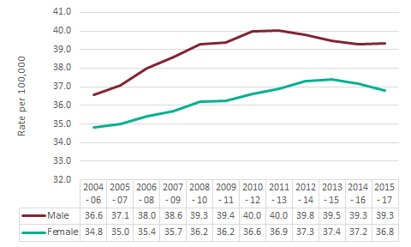
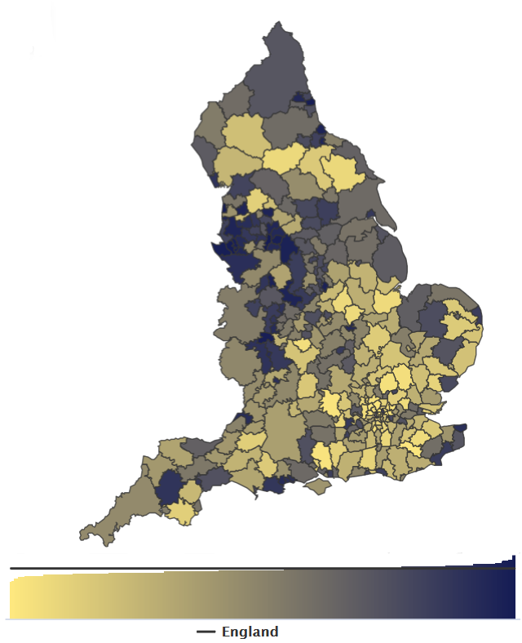
Local Alcohol Profiles for England: August 2019 Alcohol-related cancer incidence
Alcohol-related cancer incidence rates are higher for those in the most deprived decile (40.5 per 100,000) compared to the least deprived decile (35.4 per 100,000). For 2015-2017, Manchester (49.4 per 100,000) had the highest rate followed by Blackpool (48.8 per 100,000), while Westminster (28.8 per 100,000) had the lowest followed by Kensington & Chelsea (29.6 per 100,000).
Figure 2. Alcohol-related cancer incidence, District and UA
Between 2015-17 there were an estimated 58,200 cancer registrations which were related to alcohol consumption. This equates to approximately 19,400 new cancer cases each year attributed to alcohol.
Figure 1. Alcohol-related cancer incidence by gender, England
The rate of alcohol-related cancers in males increased gradually between 2004-06 and 2011-13 and fell in each subsequent period. In the three-year period 2015-17, the rate in males remained static at 39.3 alcohol-related cancers per 100,000 population. The rate of new alcohol-related cancers in females increased each period to 2013-15 but has reduced for the most recent two periods and is currently 36.8 per 100,000 population.

Slide 4
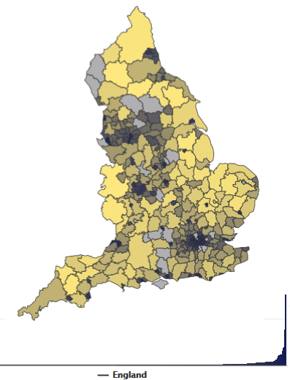
Local Alcohol Profiles for England: August 2019 Number of premises licensed to sell alcohol per square kilometre
This indicator shows the number of premises with certificates permitted to sell or supply alcohol on-trade and/or off-trade per square kilometre for each local authority in England. By including this data in LAPE, local authorities can compare the number and density of licensed premises in their area with similar areas and with areas experiencing similar harms.
For 2017/18 there were 164,857 premises across England licensed to sell alcohol. With the exception of Blackpool, the areas with the greatest density of premises were all districts of London, followed by the major cities of Liverpool and Manchester. This is to be expected as we know the density of licensed premises is highly correlated with population density i.e. there are more premises in areas with more people.
This results in a marked variation in the density of licensed premises across the local authorities of England. This is illustrated in the map below.
Figure 3. Number of premises per km², District and UA
The numerator is published as National Statistics by the Home Office. It is based on administrative data returns from Local Authorities (LAs). However, premises may have a licence to sell alcohol but not actually sell alcohol. Also, premises may have ceased trading since a licence was granted but not yet been removed from LA records. For a small number of LAs there are missing or incomplete data and hence LAPE is unable to provide a value for those areas. Correspondingly, the England value is based on LAs with a known number of licensed premises only.

Slide 5
Local Alcohol Profiles for England: August 2019 Background
The Local Alcohol Profiles for England (LAPE) have been published since 2006. These profiles have been designed to help local government and health services assess the effect of alcohol use on their local populations. They inform commissioning and planning decisions to tackle alcohol use and improve the health of local communities.
Methods used in LAPE
Information about the methods used to generate the indicators in LAPE can be found in the definitions tab on the LAPE site: https://fingertips.phe.org.uk/profile/local-alcohol-profiles
A full explanation of alcohol-attributable fractions and indicator revisions can be found in the LAPE User Guide: https://fingertips.phe.org.uk/documents/LAPE_2017_User_Guide_071117.pdf
To access the Local Alcohol Profiles for England dataset by Local Authority see our interactive data tool here

